Slide 1

Panel Data Analysis
Nature of panel data
Potential insights from panel data
Example panel data
Implementing simple panel data analysis in Excel
Notes:
In this lecture I will cover the topic of panel data analysis. This is a vast and complex area, and my goal is to only provide a high-level overview and to also show you some ways to implement simple panel data analysis within Excel. A lot of data obtained available from digital marketing can typically be structured as panel data, which is why it is useful to learn about this type of analytics.
I will describe the basic structure of panel data, the types of insights you can obtain from panel data, give you an example of panel data analytics for a keywords database, and show how to implement simple panel data analysis in Excel.

Slide 2
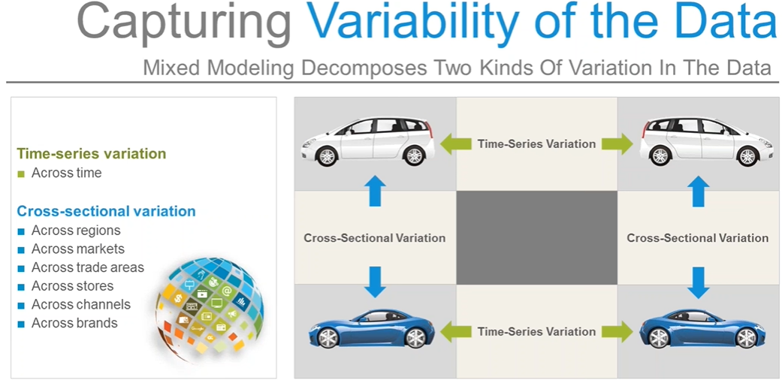
Panel Data
Across keywords used for Google AdWord
https://www.youtube.com/watch?v=TsLQTA5dkTQ

Slide 3
Panel Data
Cross sectional data means that we have data from many units, at one point in time.
Time series data means that we have data from one unit, over many points in time.
Panel data (or time series cross section) means that we have data from many units, over many points in time.
Panel Data = Cross Sectional Data+Time Series Data
Panel data (also known as longitudinal or cross-sectional time-series data) is a dataset in which the behavior of entities are observed across time.
https://www.stathelp.se/en/xtset_en.html

Slide 4
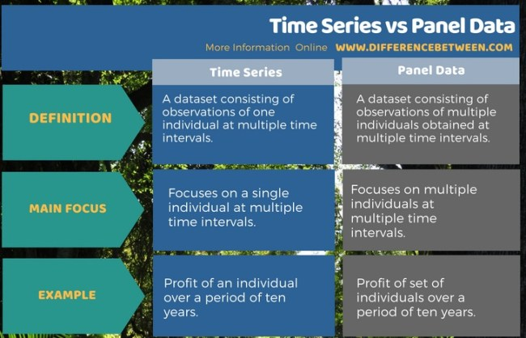
Difference Between Time Series and Panel Data
https://www.differencebetween.com/difference-between-time-series-and-panel-data/
Notes:
https://www.differencebetween.com/difference-between-time-series-and-panel-data/#Panel%20Data

Slide 5
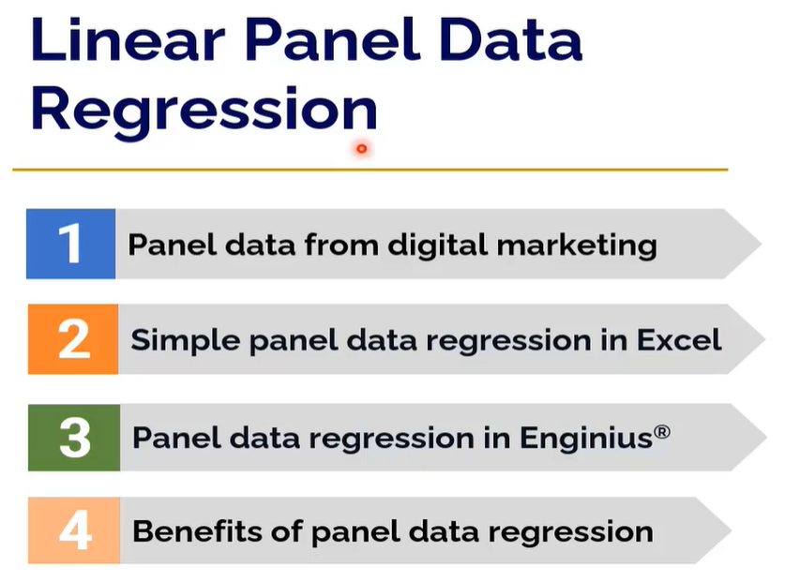

Slide 6
New Types of Marketing Data
Huge amounts of various types of data are generated by online activities of consumers and firms.
Evolution of marketing data:
Static data (from 1970’s) – one time data collection
Panel data (from 1980’s) – typically same entity (multiple entities) is observed at several points in time, but data not immediately available for analysis
“Real-time” data available for immediate analysis (from 1990’s)
Text, audio, video and other data (from the turn of the millennium)
Notes:
In marketing, we are seeing a shift from static data collection (for example, a one-time collection of data, say from a survey) towards continuous real-time data collection, such as in web logs, social networks, sensors, and even many types of transactions data. We are also seeing new types of data being collected that include non-numeric types such as text, audio, and video.
Panel data represents an intermediate point between static and continuous data, in that we obtain multiple observations of the same entity across time or across different contexts. The multiple observations could occur across time (say data collected about keyword conversions everyday), or across geographies (for example data collected about keyword conversions in the 43,000 zipcodes in the US), or in other contexts where data is collected over multiple observations. A panel data structure over three dimensions could include forecasts for a product made by many different salespeople (first dimension of the panel) for several periods in the future (second dimension of the panel) for different markets (the third dimension).

Slide 7
Brief Introduction to Panel Data Analysis

Slide 8
The General Nature of Panel Data
We observe data for the same entity (e.g., person, keyword, store, industry, etc.) in several different contexts (usually the different contexts are different points in time).
And, we observe such data for a number of entities (i.e., for a set of Panel ID – such as a set of keywords).
Notes:
The key point is that we have multiple observations of the same entity. And we have such observations for several entities (i.e. we have a panel of entities). As an example, I will use a “panel” of keywords, for which we measure various outcomes (such as clickthrough rates, conversions, impressions, etc.) over several different periods (say time of day, day of week, or monthly averages, etc).

Slide 9
Reasons for Growing Use of Panel Data Analysis
Marketing Mix (Entities, Time) ➔ Observations of Effects ➔ Analyze Variations
We can account for explicit characteristics of an entity (e.g., whether keyword is branded or unbranded) in measuring effects of marketing activities. This reduces “aggregation bias” resulting form ascribing a common effect to a marketing activity across all entities (e.g. across all keywords).
By incorporating additional sources of variation (e.g., characteristics of entities; unique conditions prevalent at each time period) we reduce model error and improve the quality and accuracy of model predictions.
We can understand how effects are changing over time (i.e. we can understand dynamics and transition behaviors such as whether branded keywords are becoming more effective over time).
Notes:
An important reason for using panel analysis with keywords is that we can identify if there are certain characteristics of keywords that provide a favorable bump in some outcome measure of interest to us, such as conversions. For example, if we find that branded keywords on average have higher conversions than unbranded keywords across different contexts, even after accounting for other factors that influence the outcome measure (such as average position of the ad, the type of kewyord match we used), then we can use more branded keywords in our campaign. Or, if we find that keywords that contain the phrase “free” only brings subscribers who generate negative customer lifetime value, we can avoid using those keywords even though we know it leads to some conversions. Such systematic patterns of performance could help you generate strategic guidelines for the search campaign.
Another reason for using panel data analysis is that the model developed using such data will usually be more accurate because you account for more sources of variation in the data. In other words, an appropriately executed panel data analysis uses more data to get more precise estimates.
Finally, with panel data you get a better understanding of the processes that change over time, such as whether the effects of keywords with the word “free” changes over time (for example, because more competitors also start using free in their search advertising). We won’t get into these dynamic aspect in this course, but this is an area where there are many emerging applications in digital marketing.

Slide 10
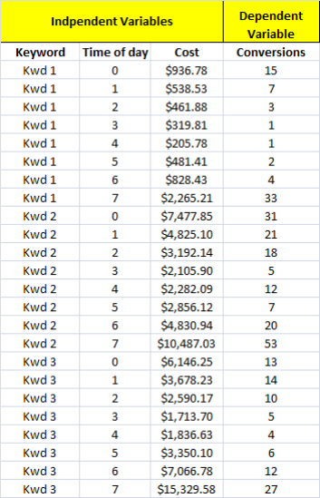
Example Panel Data
This is a balanced panel– same number of observations (8) for each unit (Kwd-Keyword).
The units can be anything – consumers, firms, countries, stores, Kwds, Apps, etc. for which we have repeated observations.
This panel data have 3 units (keywords) and each unit has one observation for each Time of Day.
Question: Do we have more conversions when we spend more money?
Midnight to 7am
Notes:
This is an example of panel data. We have three keywords and we have multiple observations associated with those keywords. We have also multiple observations associated with time of day. Here you could construct a panel of keywords (3 keywords or in other words there are 3 members in this panel), or you could construct a panel based on time of day (8 members in this panel). For each of these two panels, we have multiple observations (8 observations per panel member for keywords) and 3 observations per panel member for time of day.
Note, however, that we do not have a panel of keywords and time of day – then there would be 24 members in such a panel, and we would have only one observation per panel member, not multiple observations per panel.
Another thing to note is that we have a balanced panel here, which means we have the same number of observations for each member in the panel, but this will generally not be the case – for example, in most keyword databases, every keyword is likely to have a different number of observations associated with them. One keyword may have 5 observations, another keyword may have 10 observations, and a third may have 2 observations, and so on. Such a panel is called unbalanced. One implication of having unbalanced panel is that statistical inference would not be as precise with unbalanced panel as you might have with balanced panels.

Slide 11
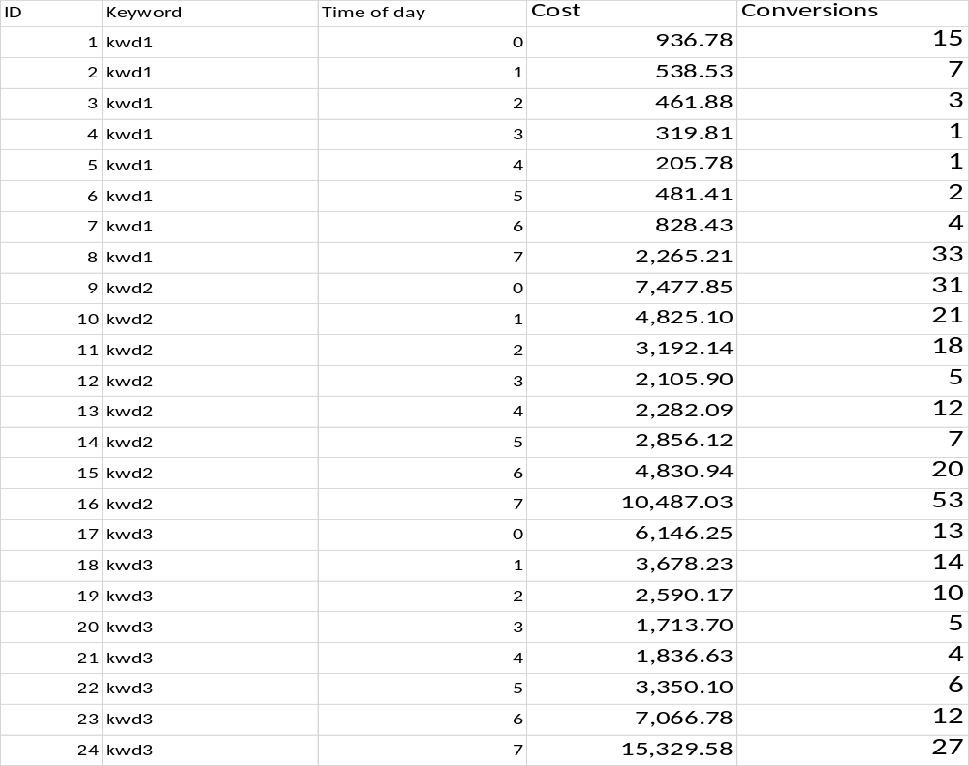
Panel Data in Excel

Slide 12
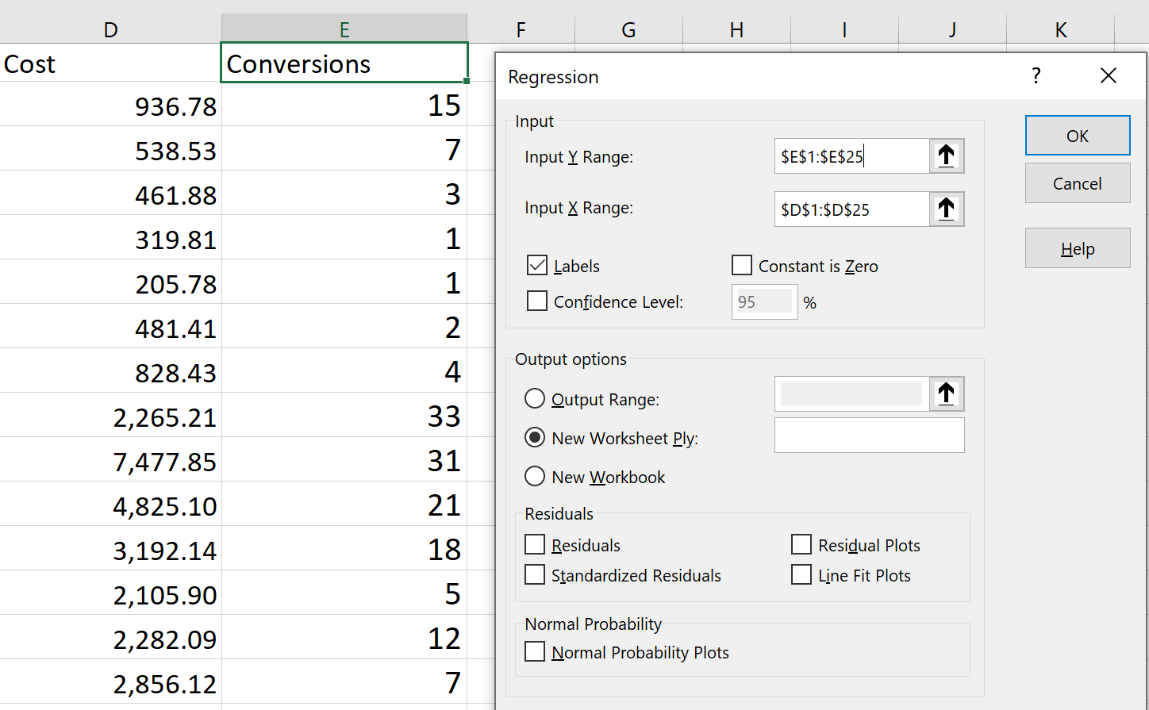
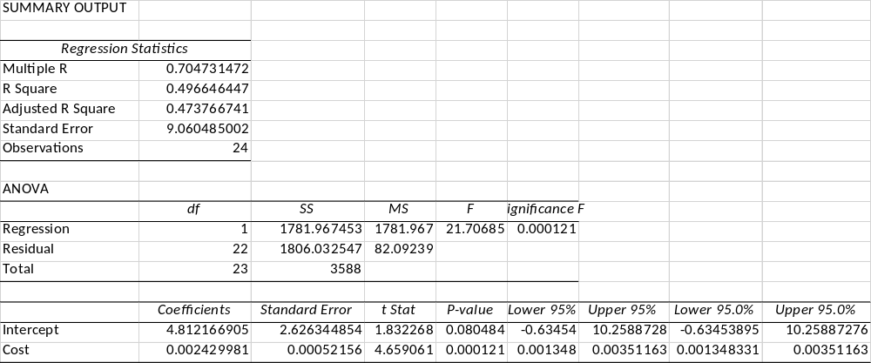
Regression in Excel
Do we have more conversions when we spend more money? ➔
Cost is treated as the only independent Variable

Slide 13

Example Results from Regular Regression
Notes:
If you take the data shown in the previous slide and run a regression analysis by ignoring the panel structure in the data, you will get a figure like what I am showing here. This shows that, on average, conversions increase when we spend more (not surprising). If you spend $2000 on one of these keywords, you should expect to realize 4.812+2000*0.00243 conversions, i.e., get, on average, 9.7 conversions.
We can represent this model as a regression line or equation. In the equation, the index i denotes keyword, and the index t denotes time of day.

Slide 14
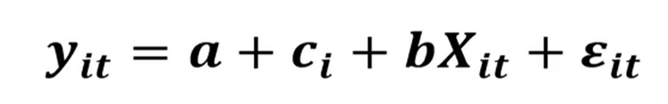
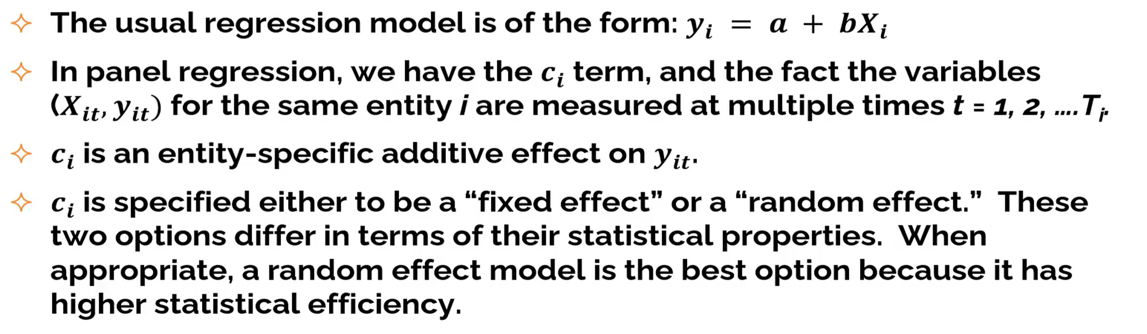
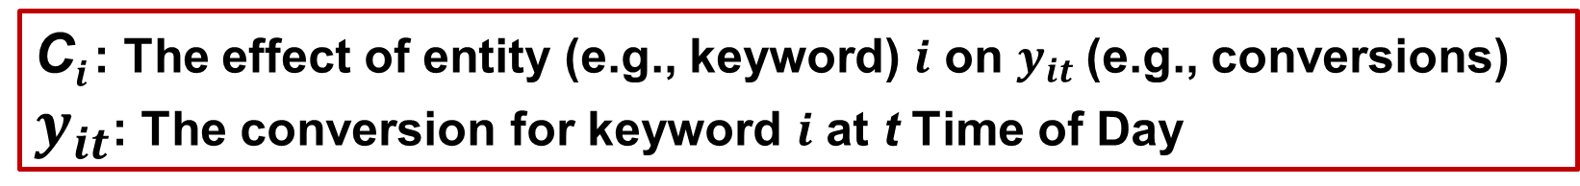
The General Structure of Linear Panel Regression Model
I = 1, 2, 3 for three keywords
t = 0, 1…7 for 8 for Time of Day
C$i$: The effect of entity (e.g., keyword) $i$ on $y_{it}$(e.g., conversions)
$y_{it}$: The conversion for keyword $i$ at t Time of Day

Slide 15
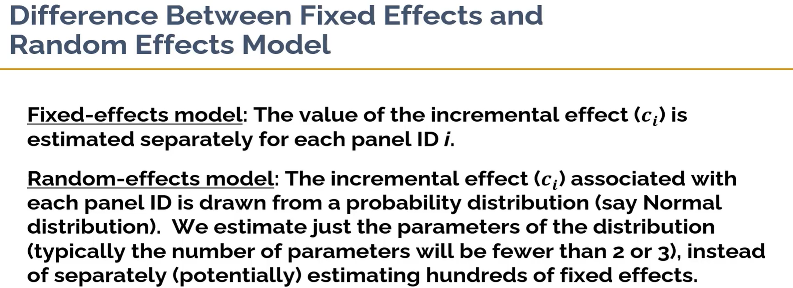

Slide 16
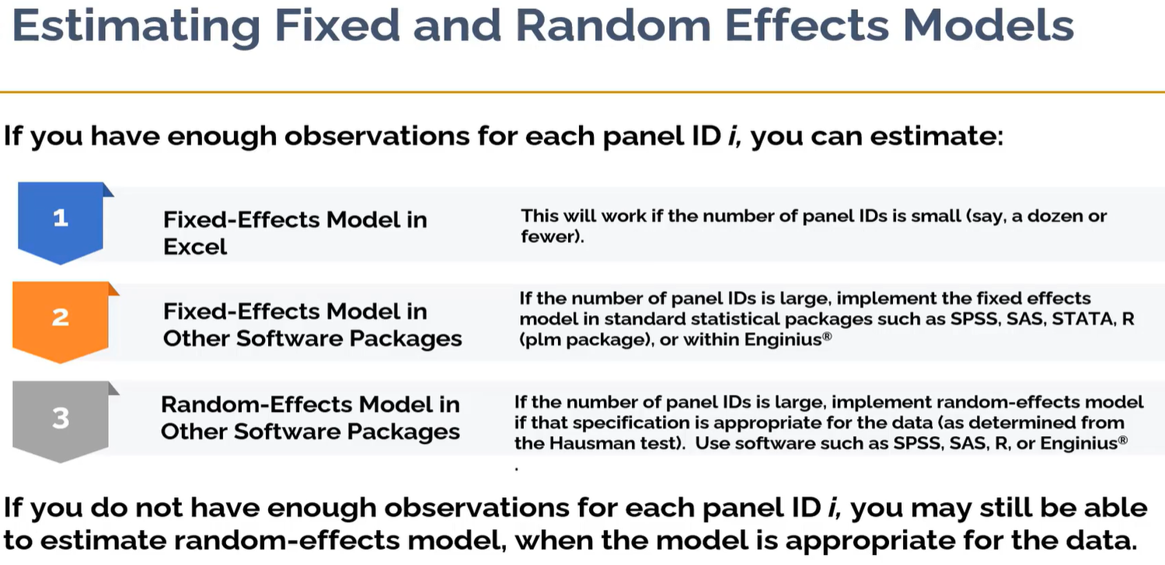

Slide 17
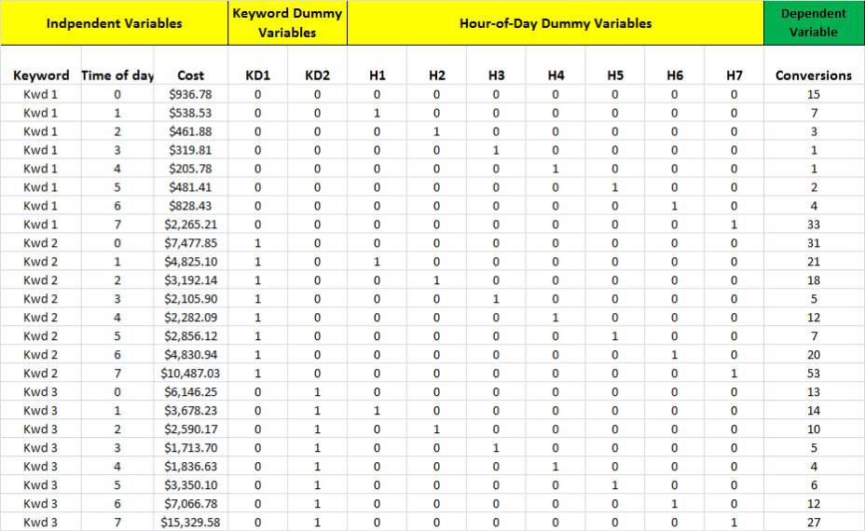
Implementing Fixed-Effects Linear Panel Regression (Analysis) in Excel
For N panel ID, we will set up N-1 dummy variables.
Dummy variables can only hold value 0 or 1.
For a set of related dummy variables, only one of them has value 1 and value 0 for others. When all dummy variables hold value 0, it represents the first Panel ID.
Notes:
Now I will show you how we set up the data for panel data analysis in Excel. We have to set up dummy variable tables. A dummy variable is one that takes on just one of two values – 0 or 1. If you have a panel with just two entities (say branded or unbranded), then you will need just 1 dummy variable.
In this example, we have three panel members (three keywords), and we will need 2 dummy variables KD1 and KD2 to set this up for panel data analysis. Or, we need 7 dummy variables to set it up for obtaining the effects of the eight time-of-day panels. Or, we need 9 variables to set it up estimating the effects associated with both the panel member and time. You can see that this type of analysis will become cumbersome if we have say 1000 keywords. We would then need to set up 999 dummy variables for analysis. Many statistical software packages such as SAS, SPSS, STATA, and PLM package in R do these types of dummy variable coding automatically.

Slide 18
Data in Excel Format
ID | Keyword | Time of day | Cost | KD1 | KD2 | H1 | H2 | H3 | H4 | H5 | H6 | H7 | Conversions
1 | kwd1 | 0 | 936.78 | 0 | 0 | 0 | 0 | 0 | 0 | 0 | 0 | 0 | 15
2 | kwd1 | 1 | 538.53 | 0 | 0 | 1 | 0 | 0 | 0 | 0 | 0 | 0 | 7
3 | kwd1 | 2 | 461.88 | 0 | 0 | 0 | 1 | 0 | 0 | 0 | 0 | 0 | 3
4 | kwd1 | 3 | 319.81 | 0 | 0 | 0 | 0 | 1 | 0 | 0 | 0 | 0 | 1
5 | kwd1 | 4 | 205.78 | 0 | 0 | 0 | 0 | 0 | 1 | 0 | 0 | 0 | 1
6 | kwd1 | 5 | 481.41 | 0 | 0 | 0 | 0 | 0 | 0 | 1 | 0 | 0 | 2
7 | kwd1 | 6 | 828.43 | 0 | 0 | 0 | 0 | 0 | 0 | 0 | 1 | 0 | 4
8 | kwd1 | 7 | 2,265.21 | 0 | 0 | 0 | 0 | 0 | 0 | 0 | 0 | 1 | 33
9 | kwd2 | 0 | 7,477.85 | 1 | 0 | 0 | 0 | 0 | 0 | 0 | 0 | 0 | 31
10 | kwd2 | 1 | 4,825.10 | 1 | 0 | 1 | 0 | 0 | 0 | 0 | 0 | 0 | 21
11 | kwd2 | 2 | 3,192.14 | 1 | 0 | 0 | 1 | 0 | 0 | 0 | 0 | 0 | 18
12 | kwd2 | 3 | 2,105.90 | 1 | 0 | 0 | 0 | 1 | 0 | 0 | 0 | 0 | 5
13 | kwd2 | 4 | 2,282.09 | 1 | 0 | 0 | 0 | 0 | 1 | 0 | 0 | 0 | 12
14 | kwd2 | 5 | 2,856.12 | 1 | 0 | 0 | 0 | 0 | 0 | 1 | 0 | 0 | 7
15 | kwd2 | 6 | 4,830.94 | 1 | 0 | 0 | 0 | 0 | 0 | 0 | 1 | 0 | 20
16 | kwd2 | 7 | 10,487.03 | 1 | 0 | 0 | 0 | 0 | 0 | 0 | 0 | 1 | 53
17 | kwd3 | 0 | 6,146.25 | 0 | 1 | 0 | 0 | 0 | 0 | 0 | 0 | 0 | 13
18 | kwd3 | 1 | 3,678.23 | 0 | 1 | 1 | 0 | 0 | 0 | 0 | 0 | 0 | 14
19 | kwd3 | 2 | 2,590.17 | 0 | 1 | 0 | 1 | 0 | 0 | 0 | 0 | 0 | 10
20 | kwd3 | 3 | 1,713.70 | 0 | 1 | 0 | 0 | 1 | 0 | 0 | 0 | 0 | 5
21 | kwd3 | 4 | 1,836.63 | 0 | 1 | 0 | 0 | 0 | 1 | 0 | 0 | 0 | 4
22 | kwd3 | 5 | 3,350.10 | 0 | 1 | 0 | 0 | 0 | 0 | 1 | 0 | 0 | 6
23 | kwd3 | 6 | 7,066.78 | 0 | 1 | 0 | 0 | 0 | 0 | 0 | 1 | 0 | 12
24 | kwd3 | 7 | 15,329.58 | 0 | 1 | 0 | 0 | 0 | 0 | 0 | 0 | 1 | 27

Slide 19
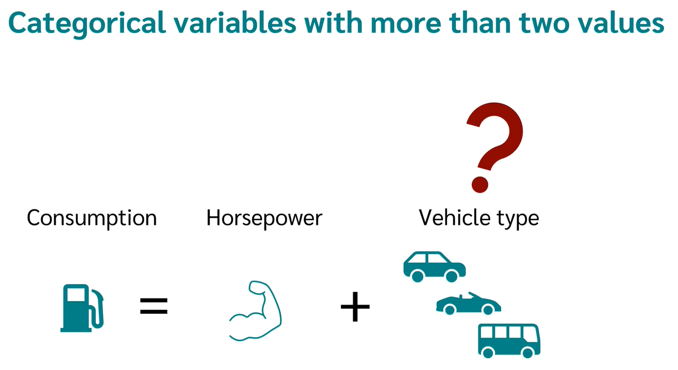
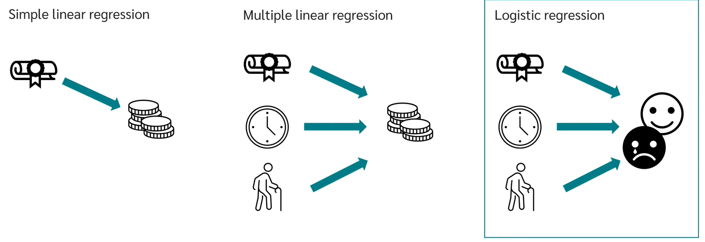
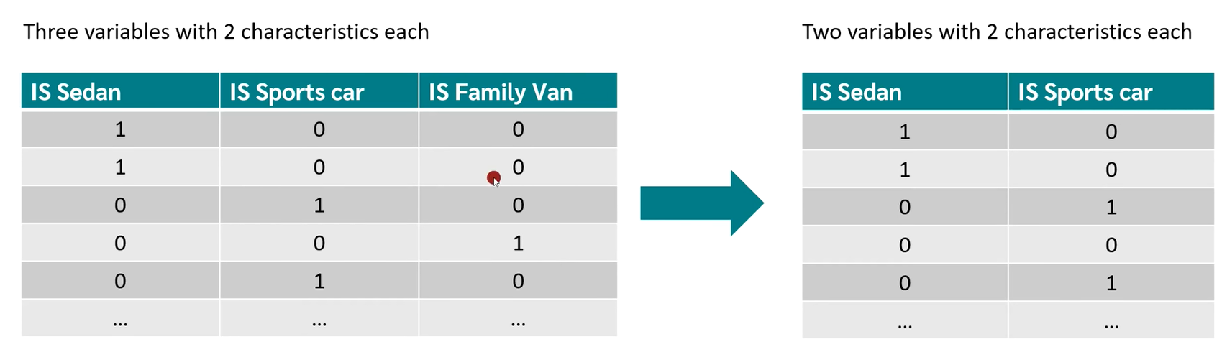
Dummy Variables
If an independent categorical variable has N possible values, we need to create N-1 dummy variables.
https://youtu.be/0m-rs2M7K-Y?t=1917

Slide 20
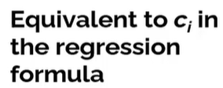
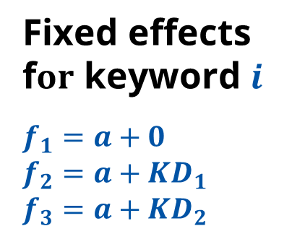
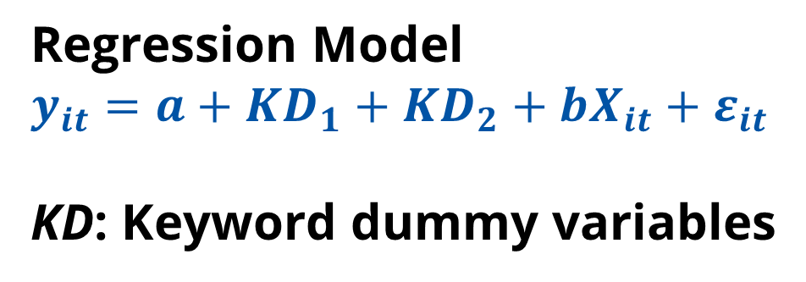
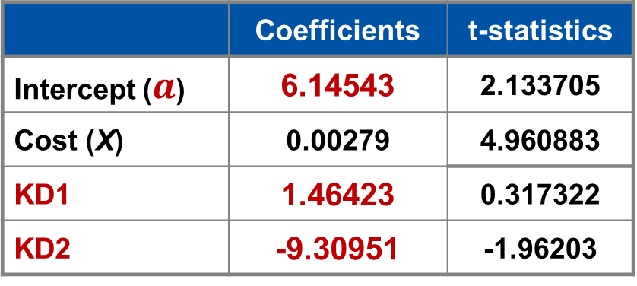
Example Analysis with Dummy Variable Coding
Estimated Regression Coefficients
 | Coefficients | t-statistics
Intercept ($a$) | 6.14543 | 2.133705
Cost (X) | 0.00279 | 4.960883
KD1 | 1.46423 | 0.317322
KD2 | -9.30951 | -1.96203
Regression Model
$$y_{it}=a+{KD}_{1}+{KD}_{2}+bX_{it}+ε_{it}$$
KD: Keyword dummy variables
Fixed effects f$or$ keyword $i$
$$f_{1}=a+0$$
$$f_{2}=a+{KD}_{1}$$
$$f_{3}=a+{KD}_{2}$$
⬅ $f_{2}=a+{KD}_{1}=\text{6.14543}\text{ +}\text{1.46423}$
f3
KWD1 do not have an an dummy variable C_{i}
KD1 is the dummy variable for KWD2
KD2 is the dummy variable for KWD3
Notes:
If you run a simple regression model with the dummy variables, you will get estimates as indicated in the top right of this slide. The constant term or the intercept is equal to 6.145, and the slope of the regression line is 0.00279. This means that if you spend 2,000 dollars on keyword 1, you should expect to get 6.145+2000*0.00279 conversions, i.e. , which means you should expect to get 11.73 conversions. On the other hand, if you spend $2,000 on keyword 3, you should expect to only get 2.42 conversions.

Slide 21
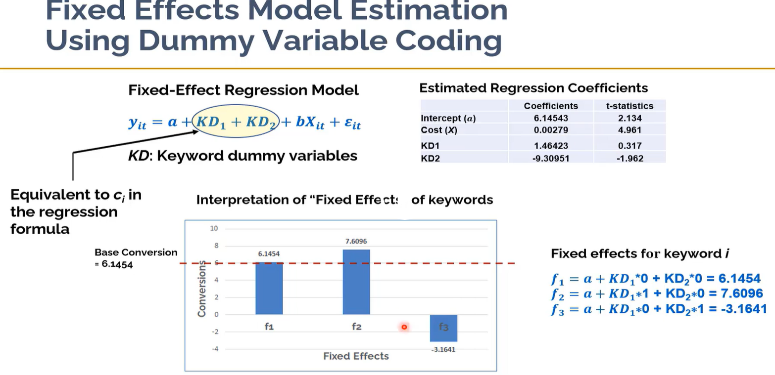

Slide 22
Example Results from Simple Panel Regression
This chart show the impacts of converions by different keywords.
Kwd2
Kwd1
Kwd3
Notes:
Here I am showing a pictorial representation of the panel data analysis I just showed you. The plot shows the variations in the conversion performance of the three keywords. We see that keyword 2 gets more conversions compared to keywords 1 and 3. You will also notice that by accounting for these keyword-level differences, we get a slightly steeper regression line (the slope changed from 0.00243 to 0.00279. (In other words, we get a more precise estimate of the effect of our spending levels).
All else equal, we get an increase of 1.464 conversions for keyword 2 compared to keyword 1, and a bump of 10.76 conversions over keyword 3, which is the worst performing. Keyword 3 costs a lot for the conversions it generates, which is obvious if you take a look at the raw data.
It would be useful for you to replicate the analysis I have shown you to get a better understanding of panel data analytics. I will upload this data set at the course site.

Slide 23
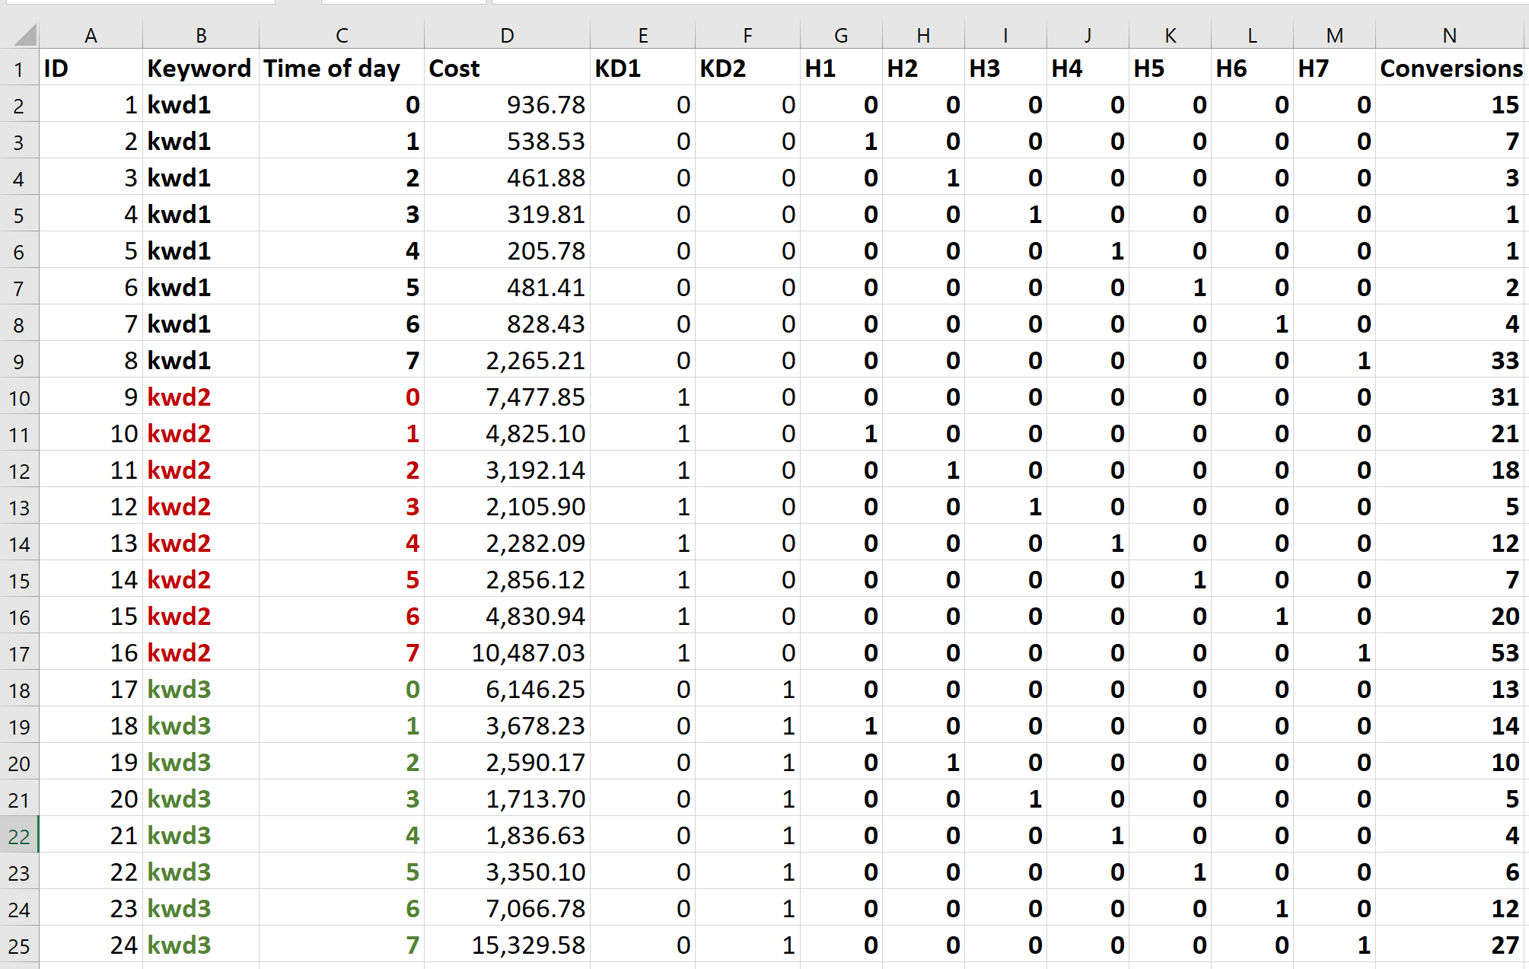
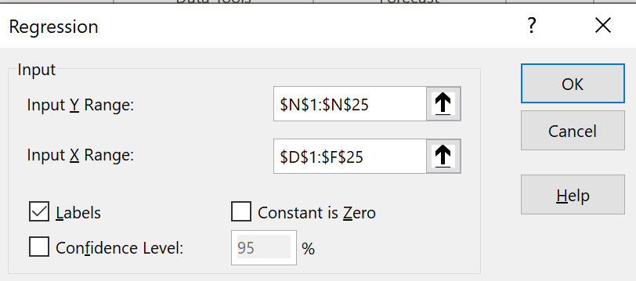
Regression Model Using Excel➔ Data➔Data Analysis➔Regression

Slide 24
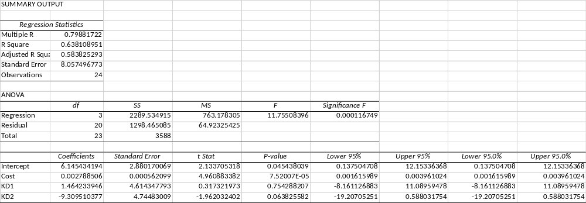
Regression Model Using Excel
 | Coefficients
Intercept | 6.145434194
Cost | 0.002788506
KD1 | 1.464233946
KD2 | -9.309510377

Slide 25
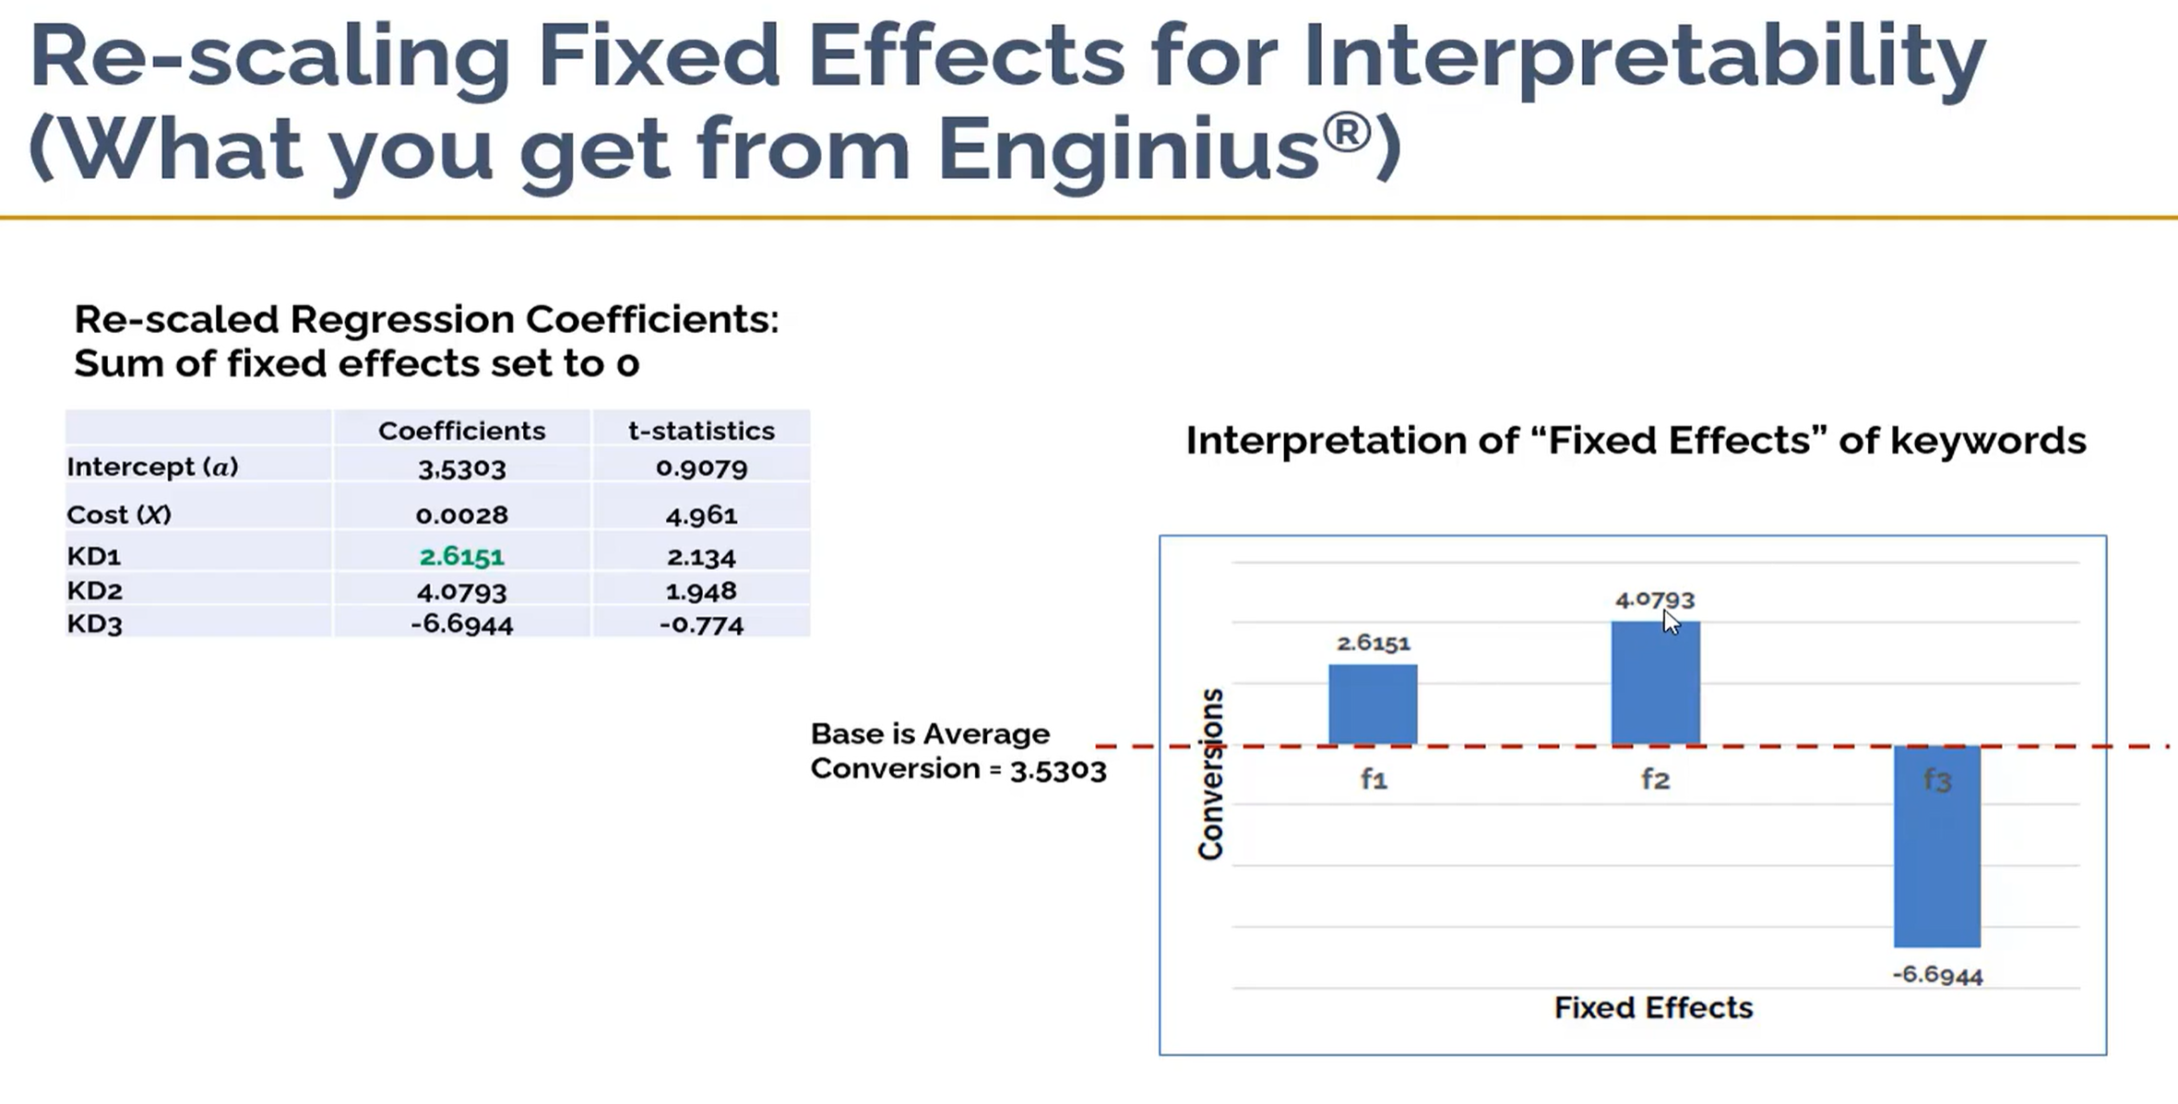

Slide 26
Hour-of-Day Fixed Effects
Time of day | Conversions
0 Average | 19.67
1 Average | 14.00
2 Average | 10.33
3 Average | 3.67
4 Average | 5.67
5 Average | 5.00
6 Average | 12.00
7 Average | 37.67
Grand Average | 13.50
Notes:
This is the result you should get if you regress conversions against the 7 dummy variables for hour-of-day. The intercept value of the regression is 19.667, which in this case will be for the base hour of 0, i.e. for midnight. All other fixed effects are measured with respect to this base level. See if you can replicate these results from within Excel.
You could also run a regression including both hour-of-day effects and costs. If you do that, you should see here that cost becomes an insignificant factor in explaining performance. In other words, the effect of spending on conversion is really due to hour-of-day effects (i.e., we spent more during certain hours).
One general caveat about regression models. As you add more variables to a regression model, the model could become less useful for forecasting with new data. For forecasting, it is generally useful to build reliable models with fewer variables, rather than building a model with a large number of variables.

Slide 27
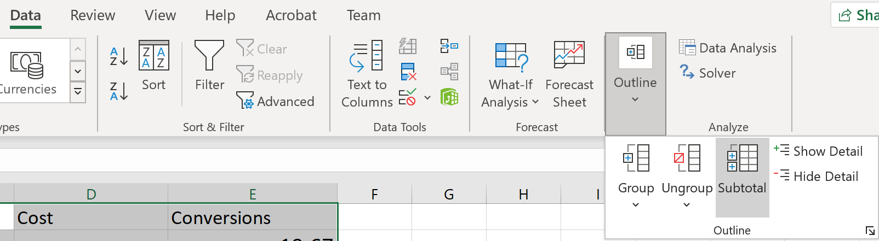
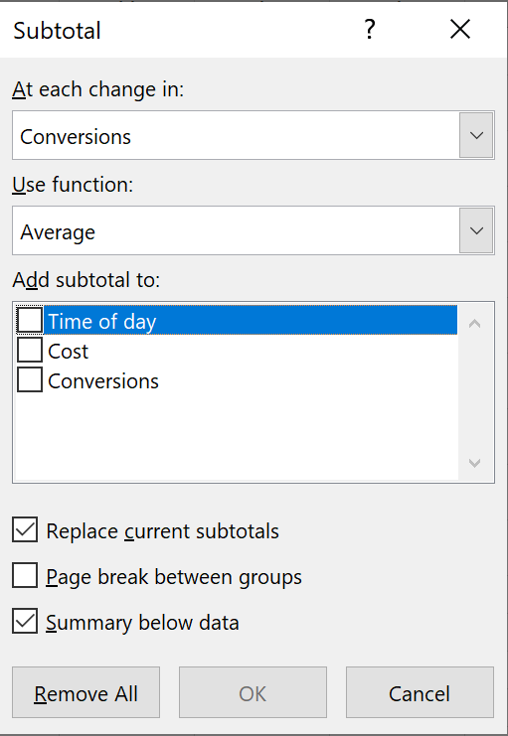
In Excel, sort by Time of Day
Use Data/Subtotal to calculate the average conversion over Time of Day.

Slide 28
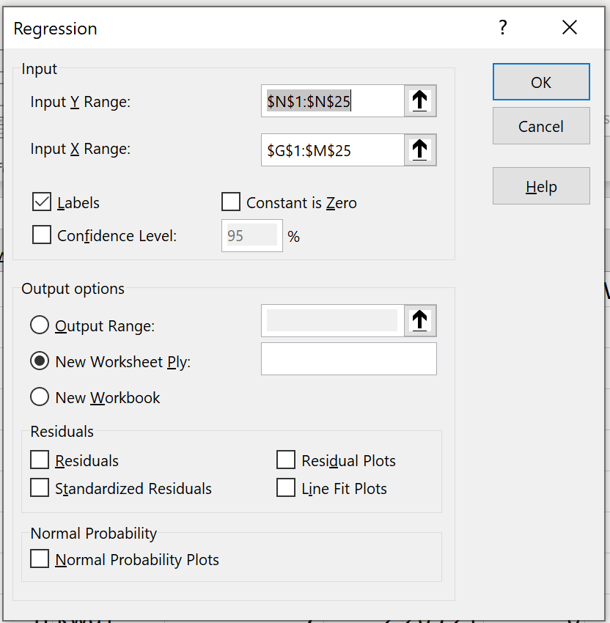
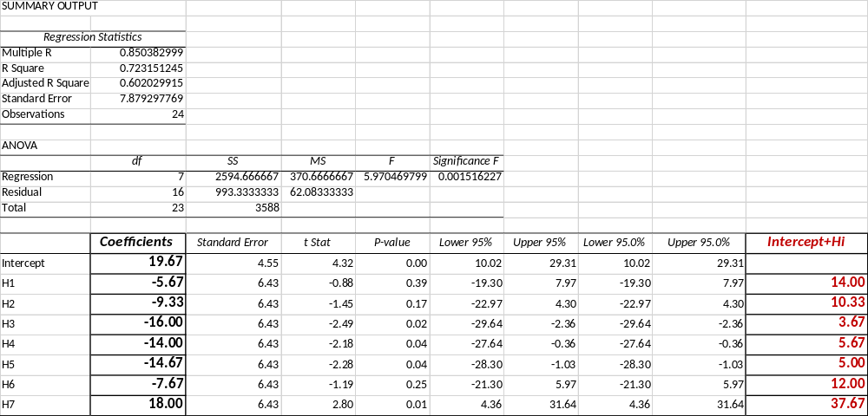
Using Excel for Regression Analysis

Slide 29
Forecasting Model
You could also run a regression including both hour-of-day effects and costs. If you do that, you should see here that cost becomes an insignificant factor in explaining performance. In other words, the effect of spending on conversion is really due to hour-of-day effects (i.e., we spent more during certain hours).
One general caveat about regression models. As you add more variables to a regression model, the model could become less useful for forecasting with new data. For forecasting, it is generally useful to build reliable models with fewer variables, rather than building a model with a large number of variables.

Slide 30
Panel Data with Simple “Fixed Effects”
Increasing in spending at AdWord marketing
Keywords have intrinsic effect on conversions.
Notes:
In this chart, I am providing a conceptual representation of the panel data analysis we just did. The ellipse represents a panel of keywords. Think of each observation as a level of spending. Then, we see that the conversions increases on average with increasing spend, i.e., the ellipses shift upward. Each keyword is represented in one color – we see that conversions increase for both keywords. So the average increase in conversions over the three observations is not due to the nature of the keywords because it increases for all keywords, but is really due to spending which increases as we move from observation 1 to observation 3. Thus, we can separate out the effects of the intrinsic characteristics of keywords (i.e., red converts better than green), from the increases in conversion due to additional spending.
The effects here associated with each keyword is a “fixed effect” because there is a constant difference between the keywords across different observational contexts. The red keyword convert between than the green keywords in all contexts. A panel data model to obtain these types of constant effects is called a fixed effects model. For this course, we will focus on fixed effects.

Slide 31
More Complex Panel Data Example
Notes:
This is a more complex pattern that you could explain with panel data. Here although the average conversion across the panel is increasing (as before), the green keyword is increasing more rapidly than the average, whereas the red keyword experiences a slight decline even as the average performance across all keywords in the panel is increasing. This means that some other aspects of the keyword or some aspects of the observational context are affecting the two keywords differently. You could set up a panel model that allows for the slopes of the regression line for each keyword to vary to more fully capture these types of effects. For the purposes of this course, what I have shown is a simple panel data model, without this type of sophisticated specification.

Slide 32
Implementing Fixed Effects Panel Data Analysis in Excel
A fixed-effects panel data model can be estimated in Excel using dummy-variable coding.
To model N fixed effects you need N-1 dummy variables – example, for 3 fixed effects (i.e., 3 keywords), you need 2 dummy variables.
Fixed Effects panel data analysis can be done in Excel if the number of fixed effects is small (less than 16).
Notes:
Excel has a limit of 16 independent variables.
In random effects models, instead of specifying a fixed effect for each keyword, you could specify a distribution (e.g., a Normal distribution in the distribution of the effects of keywords) and simply estimate the parameters of the Normal distribution, which could simplify the analysis in some contexts.
For this course, we will implement fixed effects model in Excel, which should provide you an understanding of the main benefits of panel data analysis.

Slide 33
General Approaches to Modeling Panel Data
If there is a large number of panel members whose effects we need to account for, we have two options:
  Implement “fixed effects” model in standard statistical software such as SPSS, SAS, STATA, or R. This works best if there is a sufficient number of observations for each fixed effect.
Notes:
In standard statistical packages, the dummy variable coding is done automatically.

Slide 34
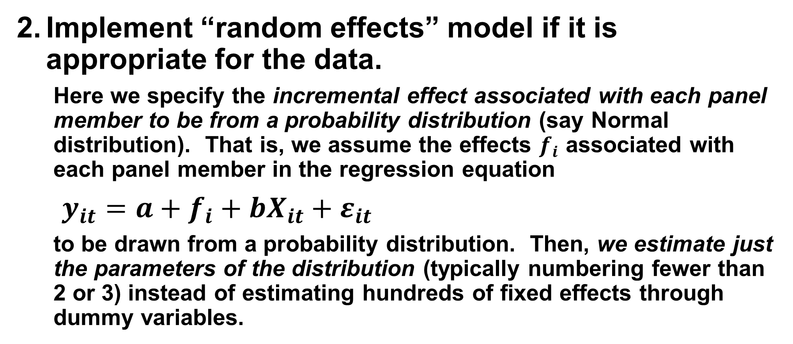
General Approaches to Modeling Panel Data
Implement “random effects” model if it is appropriate for the data.
  Here we specify the incremental effect associated with each panel member to be from a probability distribution (say Normal distribution). That is, we assume the effects $f_{i}$ associated with each panel member in the regression equation
  $y_{it}=a+f_{i}+bX_{it}+ε_{it}$
  to be drawn from a probability distribution. Then, we estimate just the parameters of the distribution (typically numbering fewer than 2 or 3) instead of estimating hundreds of fixed effects through dummy variables.
Notes:
An alternative way to conduct the simple panel data analysis is to specify a random effects model, which is statistically efficient (i.e. we get estimates with lower variance) and is to be preferred generally from a statistical point of view. There are also some other advantages of random effects models from a statistical perspective. However, it is often less useful for managerial decision making.
From a managerial perspective, my recommendation would be that if you do not have a sufficient number of observations to assess the fixed effect of each panel member, then consolidate panel members into larger groups, and then estimate fixed effects for the larger groups for which you have sufficient observations.
Advanced software packages provide a test to check whether a random effects model would be appropriate for the data. The test is called a Hausman test.

Slide 35
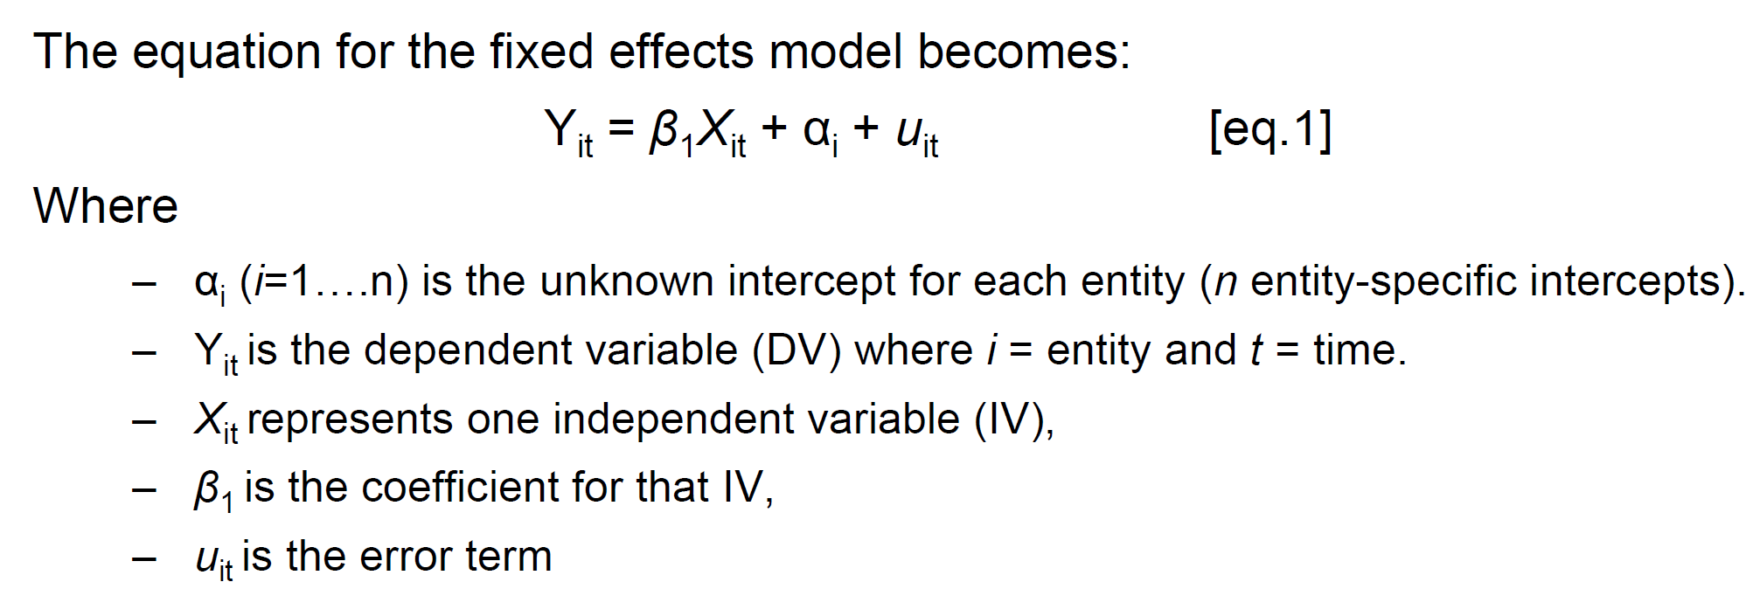
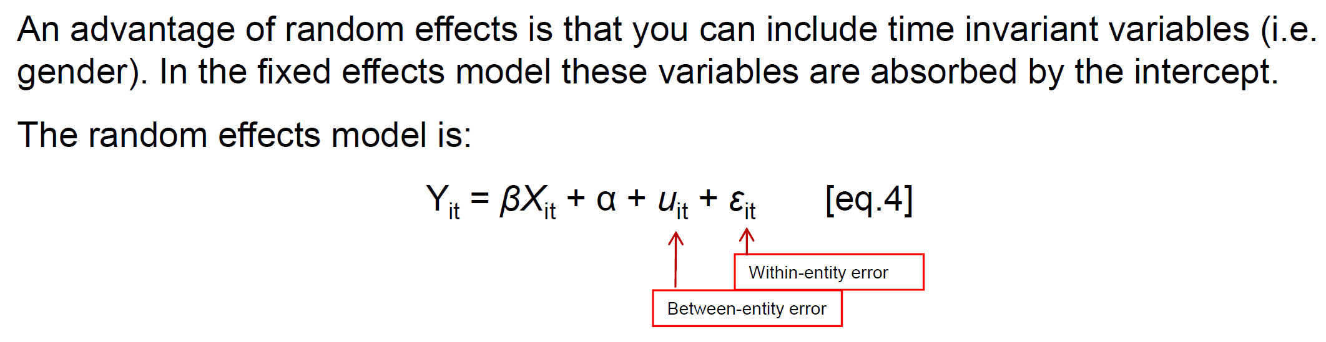
https://www.princeton.edu/~otorres/Panel101.pdf

Slide 36
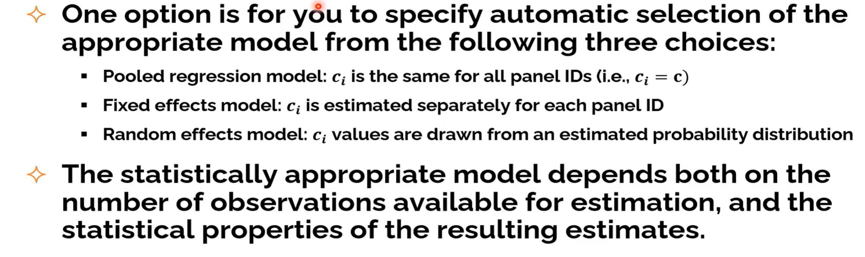
Panel Data Analysis in Enginius

Slide 37
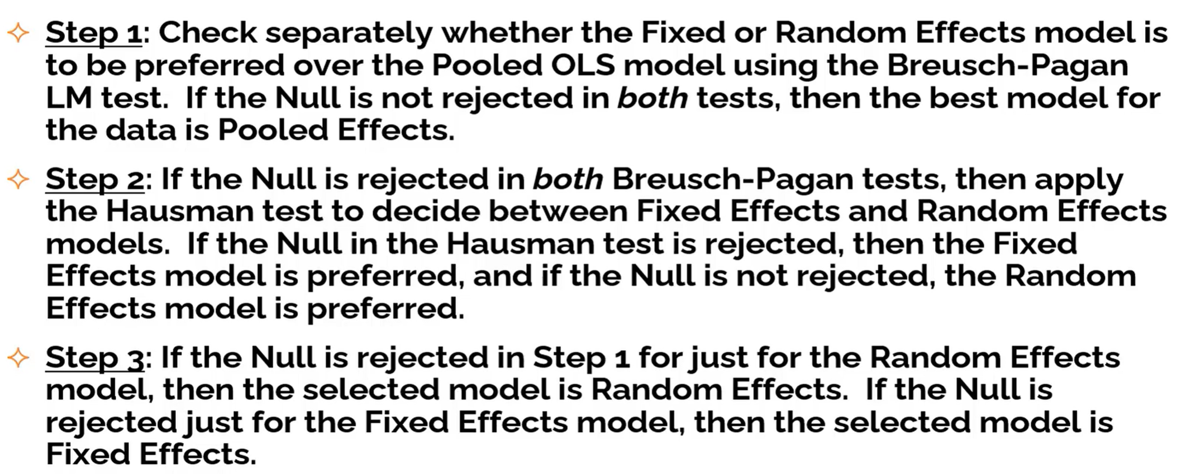
Statistical Tests for Automatic Model Selection in Enginius

Slide 38
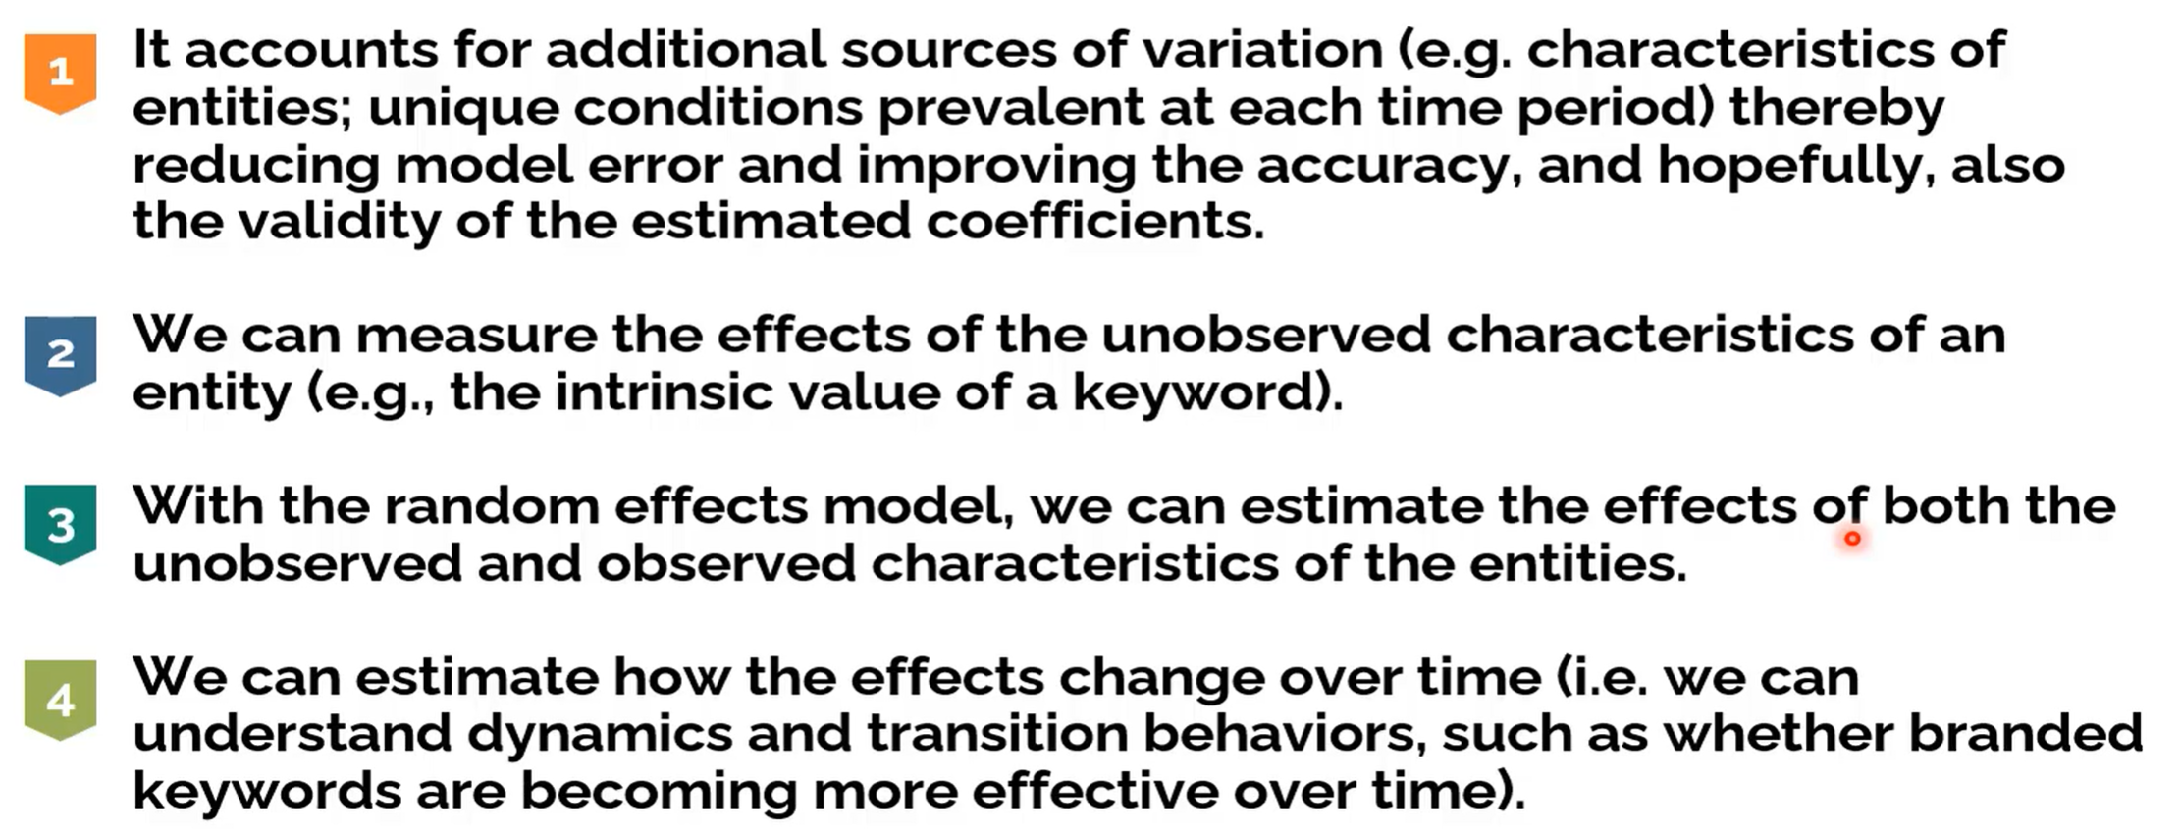
Benefits of Panel Data Regression

Slide 39
Resources
Panel Data Example in Excel
https://help.xlstat.com/s/article/panel-regression-in-excel?language=en_US
https://www.aptech.com/blog/introduction-to-the-fundamentals-of-panel-data/
** Panel Data Analysis | Econometrics | Fixed effect|Random effect | Time Series | Data Science
https://www.youtube.com/watch?v=f01WjeCdgEA
Introduction to Panel Data Analysis
http://bowenstaff.bowen.edu.ng/lectureslides/1589398888.pdf

Slide 40
The End

Slide 41
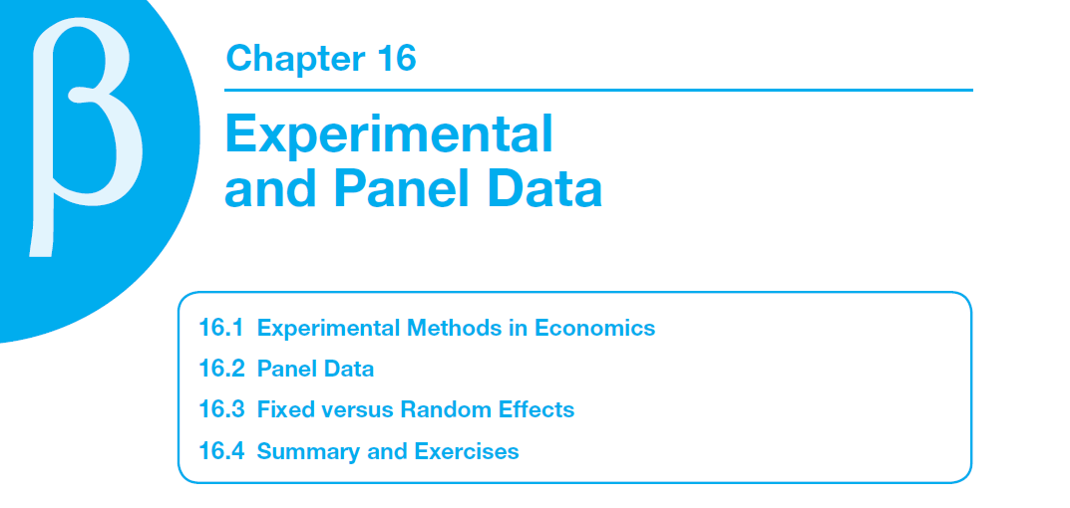
Econometrics course covers this topic
Notes:
Economics is a stand-alone subject. But until you learn the mathematical & statistical parts which are deeply ingrained with the subject, you wouldn’t be able to use the concepts well. And there lies the importance of econometrics. Below is the list of top Econometrics Books –
Mastering Metrics from #1 author is easier
Mostly Harmless Econometrics: An Empiricist’s Companion ( Get this book ) ➔ Not as easy
Using Econometrics: A Practical Guide ( Get this book )
Introductory Econometrics: A Modern Approach ( Get this book )
Introduction to Econometrics, (Pearson Series in Economics) ( Get this book )
Econometric Analysis of Cross Section and Panel Data (MIT Press) ( Get this book )
Microeconometrics Using Stata ( Get this book )
Econometric Analysis ( Get this book )
A Guide to Econometrics ( Get this book )
Basic Econometrics (Irwin Economics) ( Get this book )
Econometrics for Dummies ( Get this book )
Let us discuss each of the Econometrics books in detail along with its key takeaways and reviews.

Slide 42
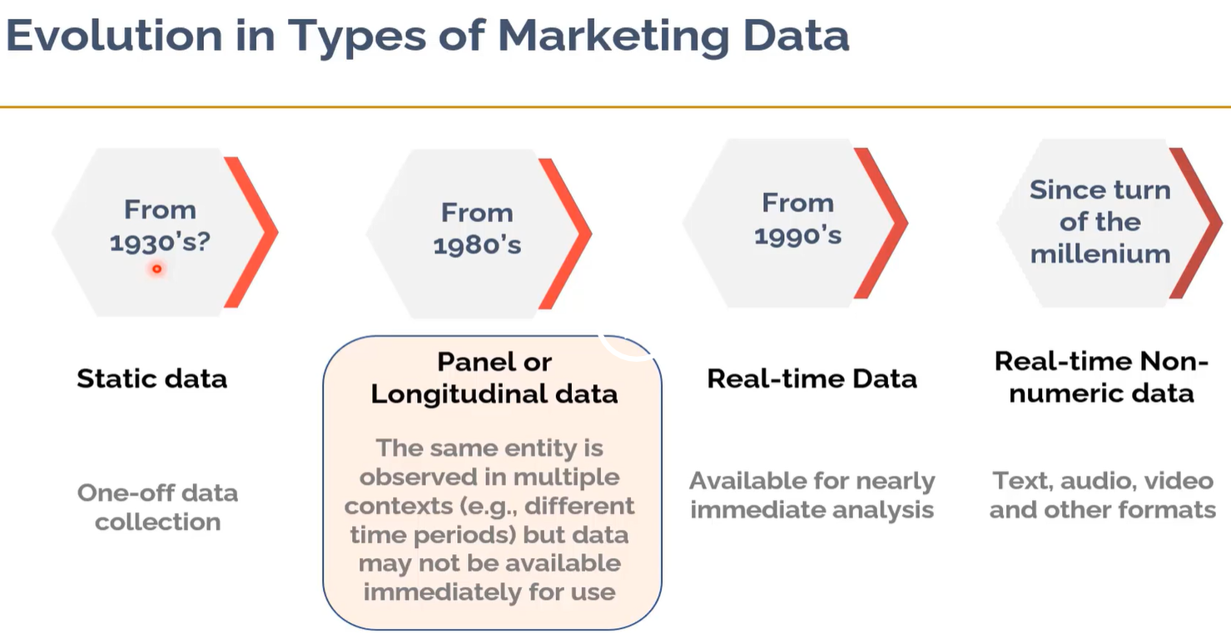
(One Time)

Slide 43
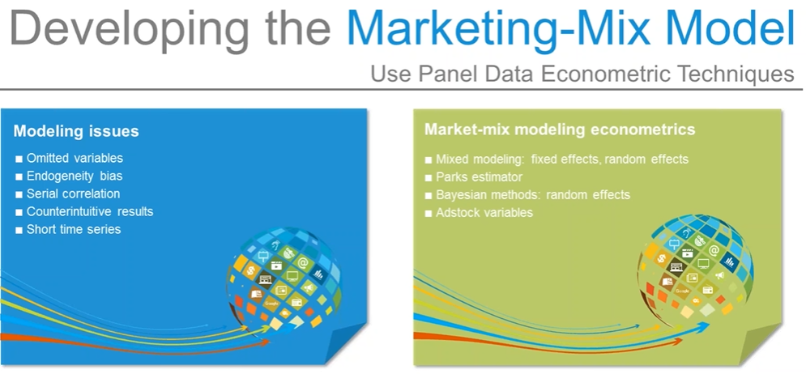
Panel Data
https://www.youtube.com/watch?v=TsLQTA5dkTQ

